Slide 1
AOL to Scout FAQ for Parents
Silver Comet District
Atlanta Area Council

Slide 2
Cub Scout Program Review
Kindergarten through 5th grade, segregated into dens by age. Scouts crossover into Troops at the end of 5th grade (or when they turn 10 years old and have also earned their Arrow of Light).
Packs are typically composed of Scouts from a few select schools or churches.
Parents play a “hands on” role and are vital to the successful operation of the program.
The Pack Committee should meet regularly and make decisions as a group.

Slide 3
Scouts BSA Introduction
Scouts can continue with their Troop until 18 years of age
Troops draw Scouts from multiple locations throughout a geographic area.
Every Troop is different – find one that works for you and your family
Scout-led program

Slide 4
Organization & Structure
Patrol: a small team of eight or so Scouts, grouped together by rank or experience level, age, or common interests. Scouts learn skills together, take on leadership responsibilities, and develop friendships that will last over a lifetime.
Patrol Leader: Each Patrol is led by a Patrol Leader. A Patrol Leader helps plan, organize, and conduct Patrol meeting activities. Patrol Leaders are led by the Senior Patrol Leader.

Slide 5
Senior Patrol Leader
All Patrol Leaders report to a single Senior Patrol Leader in the Troop. The Senior Patrol Leader is the leader of the Troop.
This position is held by an elected Scout. With guidance from the Scoutmaster, they take charge of Troop meetings and of all Troop activities. They preside over the Patrol Leaders’ Council.

Slide 6
Additional Youth Leadership Positions
Scribe: keeps Troop records
Librarian: oversees the care and use of Troop printed materials
Historian: collects, assembles, and preserves Troop news, mementos, photos, etc.
Den Chief: assists a a Cub Scout Den Leader
Webmaster: maintains the Troop’s website
Quartermaster: serve as the Troop’s supply boss

Slide 7
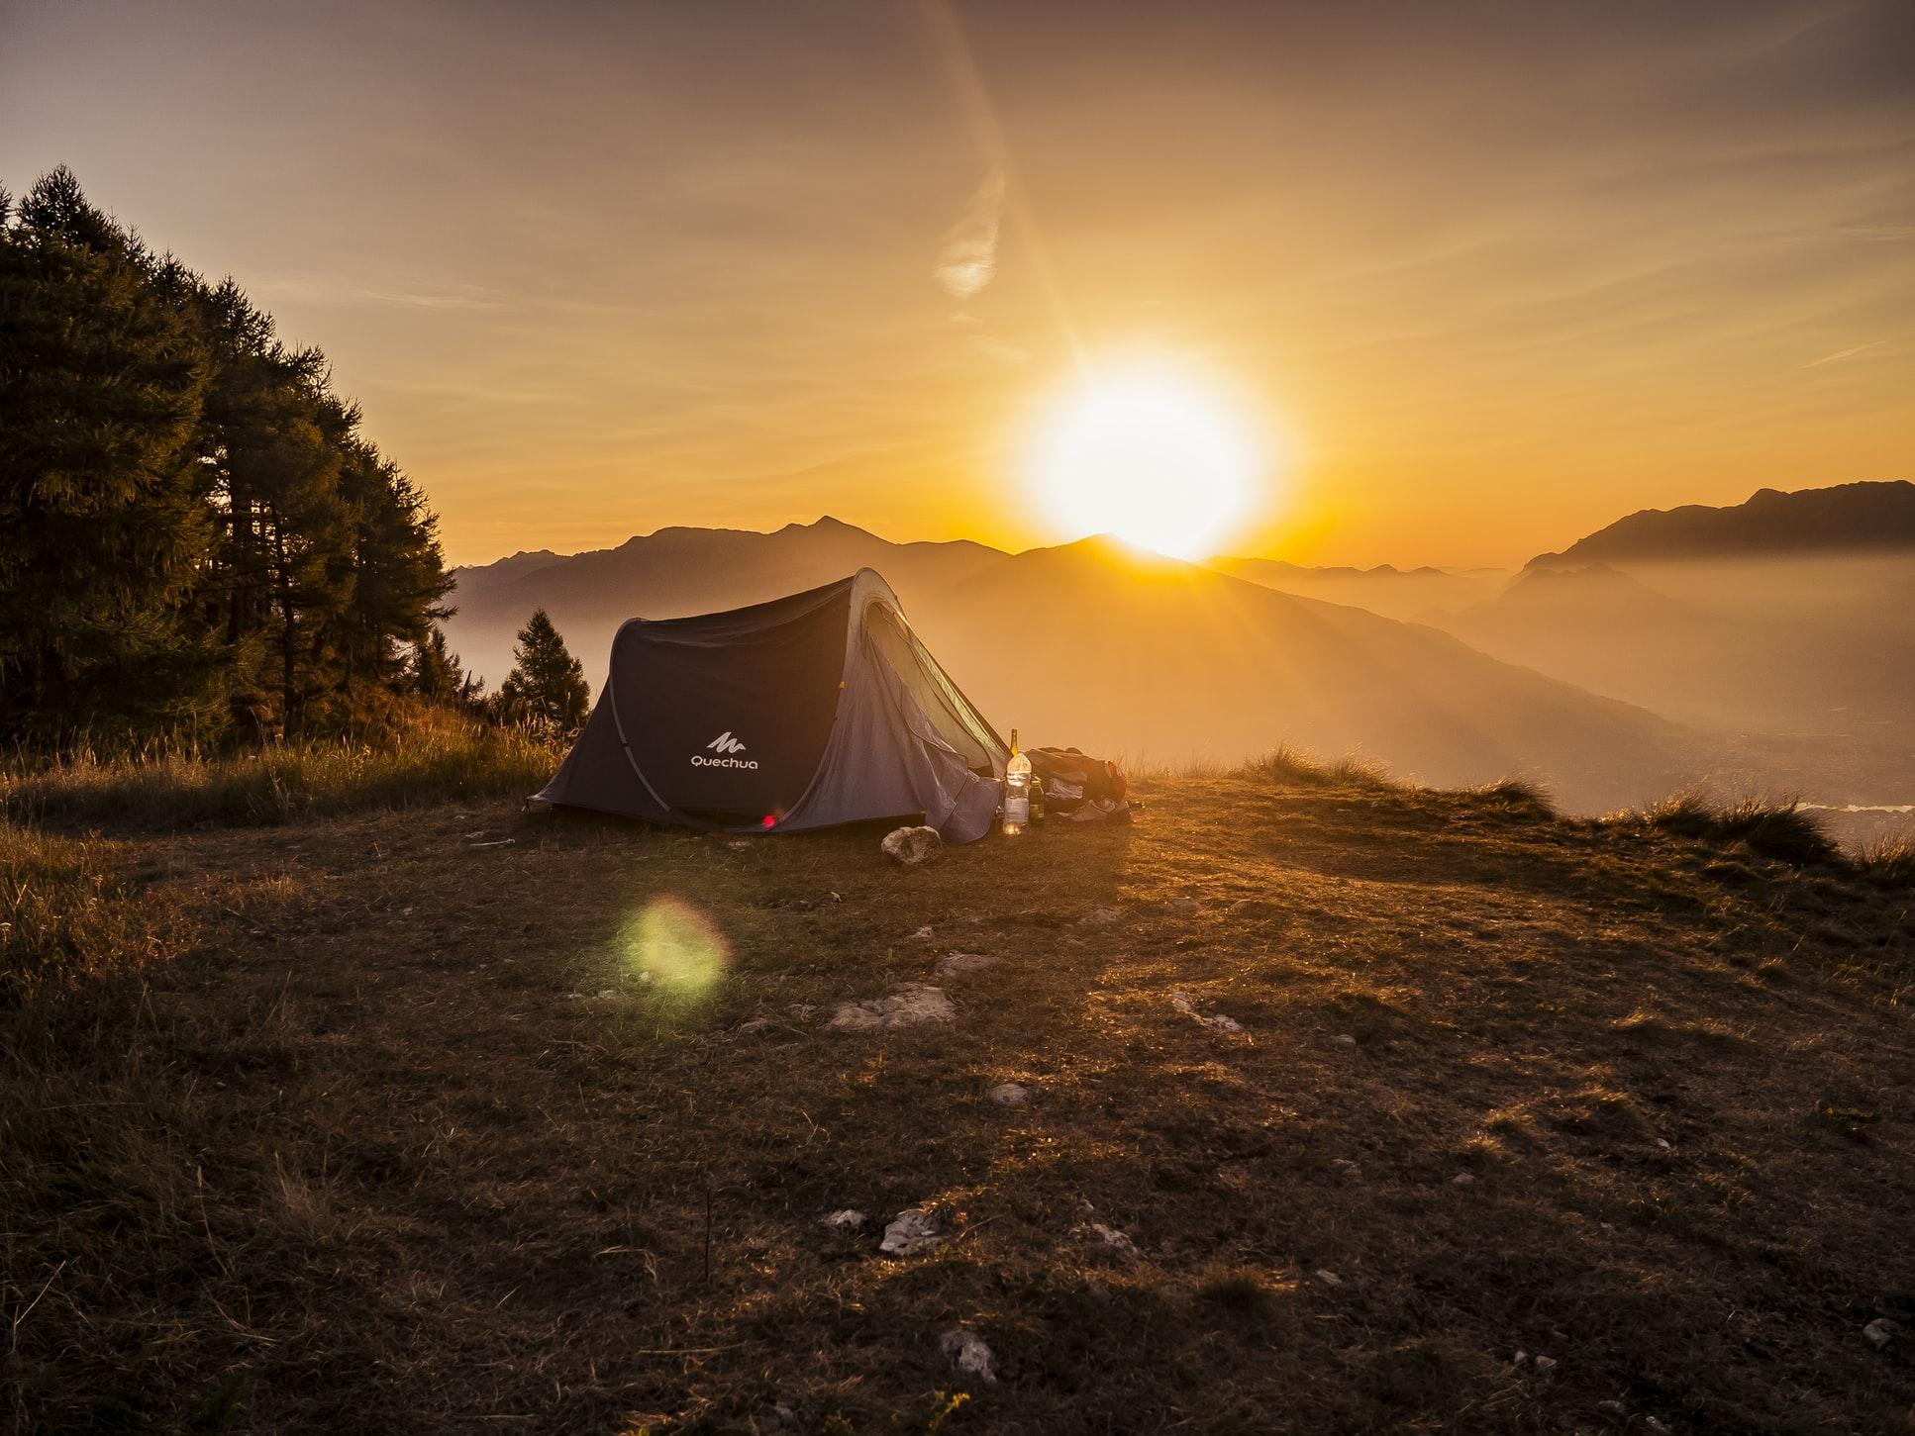
Patrol Leaders Council
Formed by all Scouts with leadership positions within the Troop
The PLC meets regularly to plan the upcoming Troop meetings and outings
The Scoutmaster of the Troop and additional adult leaders are present to offer guidance

Slide 8
Adult Participation in Scouts BSA
There are numerous ways for adults to be involved in the Troop for adults.
Scoutmaster (SM)
Assistant Scoutmasters (ASM’s)
Committee Members:
Committee Chair
Treasurer
Advancement Chair
There are also numerous non-registered ways to assist the Troop as well as your Scout, which we’ll cover later.

Slide 9
Troop Meetings
Opening Ceremony
Instruction
Flags, Scout Oath, Scout Law
Period of instruction or into to a Merit Badge
Announcements
Games / Social
Upcoming outings, service projects, etc.
Organized games, social time
Patrol Time
Closing
The Troop breaks down into patrols
Scoutmasters Minute, closing comments

Slide 10
Court of Honor
Troops regularly hold a meeting called a Court of Honor. These meetings typically are held quarterly (but again, each Troop is different).
The Court of Honor is to recognize the Scouts for their achievements since the last Court of Honor. All Rank advancements and Merit Badge completions will be recognized.
Family members are encouraged to attend.

Slide 11
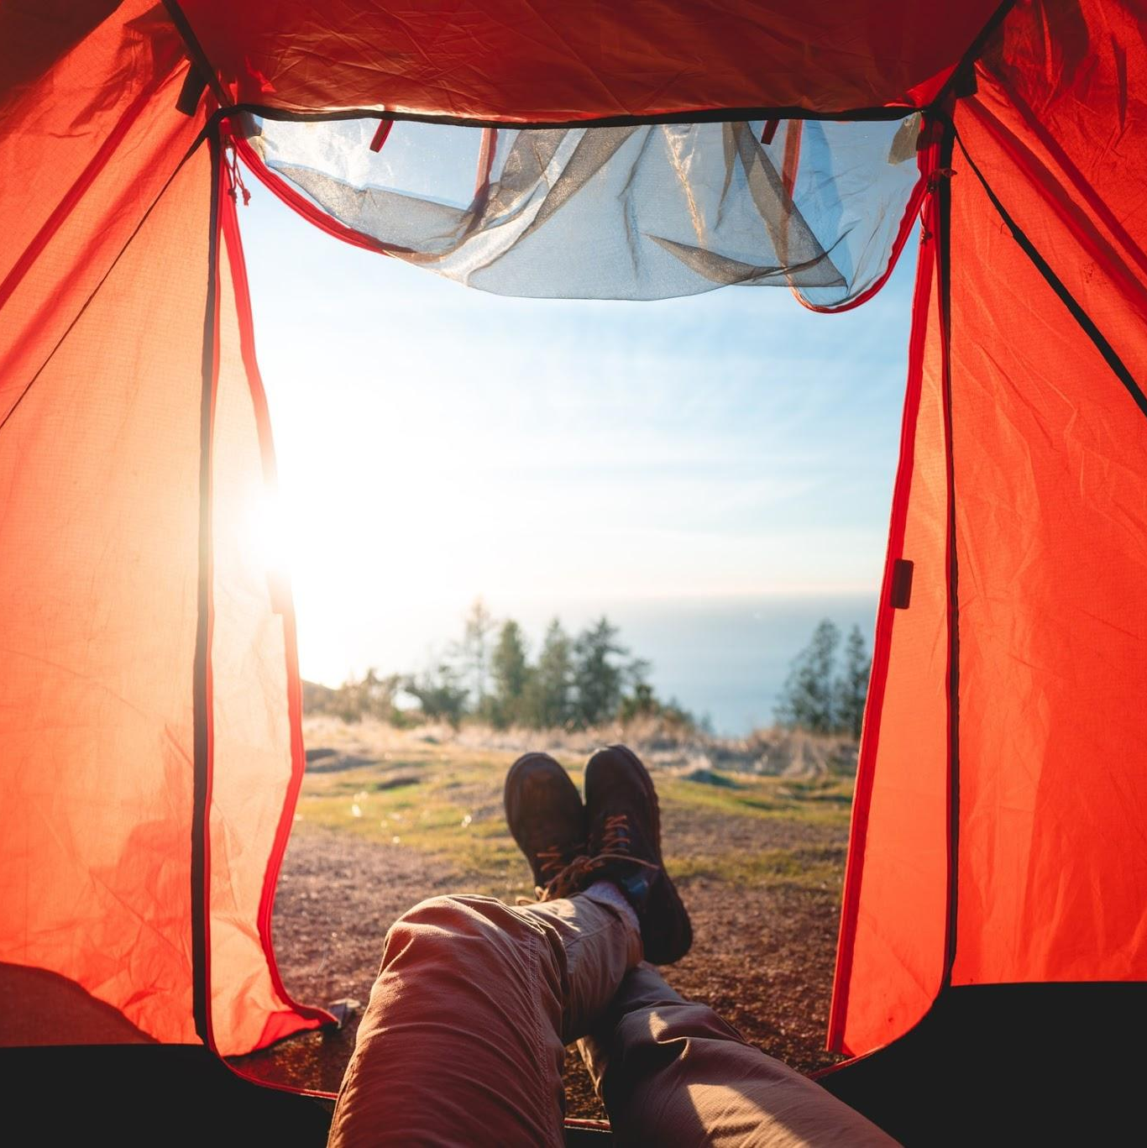
Advancement
Advancement can be broken down into two basic categories: Rank and Merit Badges.
Official records are maintained by the Troop Advancement Chair.
Some Troops utilize electronic tracking programs such as Scoutbook. Some Troops utilize the Scout’s handbook ONLY as a written record.
Talk with your Scout’s Advancement Chair to see how your Troop handles advancement recording.

Slide 12
Rank Advancement
Rank advancement is not done by grade/age like in Cub Scouts. Scouts advance at their own pace through the ranks.
Your Scout will have until their 18th birthday to advance to the rank of Eagle, Scouting’s highest Rank.
Scout Rank: This badge is awarded when the youth can demonstrate a rudimentary knowledge of Scouting skills and ideals such as tying a square knot and knowing the Scout oath, law, motto, and slogan.

Slide 13
Rank Advancement
The next three ranks focus on the areas of Scoutcraft, physical fitness, citizenship, personal growth, and Scout spirit.
Tenderfoot Rank
Second Class Rank
First Class Rank

Slide 14
Rank Advancement
Star Rank: awarded when the Scout serves actively in the Troop in a position of responsibility for at least 4 months, performs at least six hours of community service, and earns six merit badges
Life Rank: awarded when the Scout serves actively in the Troop in a position of responsibility for six months and performs six hours of community service. A Scout must also earn five additional merit badges

Slide 15
Eagle Scout Rank
Scout must earn a minimum total of 21 merit badges and demonstrate a attitude of service, leadership, and Scout spirit.
Must complete an extensive service project that the Scout plans, organizes, leads, and manages.
Applicant must also write several essays, request five recommendation letters, compile an application binder and undergo an Eagle board of review, before his application is approved at the national level.
The process typically takes several years, with the most intense and time-consuming aspects coming in the last three to six months.

Slide 16
Scoutmaster’s Conference
After all requirements for a rank have been completed, your Scout must schedule a Scoutmaster’s Conference with the Scoutmaster.
The Scoutmaster’s conference is simply a visit between the Scoutmaster and a Scout. During the conference, the two can discuss the Scout’s ambitions and life purpose, set goals for future achievement (both in Scouting and beyond), review the Scout’s participation in the Troop and explore their understanding and practice of the ideals of Scouting.

Slide 17
Board of Review
A Board of Review is the final step for Rank advancement.
Scouts schedule Board of Reviews with the Troop Advancement Chair.
Determines the quality of the Scout’s experience and decides whether the requirements for the rank have been fulfilled.
If so, the board approves the Scout’s advancement.

Slide 18
Merit Badges
Each merit badge has its own book, listing the requirements, along with information a Scout needs to be prepared to work on the merit badge.
A scout must read the Merit Badge book, complete all requirements, and then have them “signed off” by an official Merit Badge Counselor.
There are 135 different merit badges available. For a complete list, visit https://www.scouting.org/programs/scouts-bsa/advancement-and-awards/merit-badges/

Slide 19
Merit Badge Process
Scout obtains permission from the Scoutmaster (SM) to start the merit badge, and obtains a blue card
Scout should read the merit badge book and familiarize themselves with the material and requirements. Scout performs the requirements
Scout reviews requirements with merit badge counselor and obtains blue card signature.
Scout turns the blue card into the Scoutmaster and the rank patch or merit badge will be awarded according to the Troop’s policies.

Slide 20
Eagle Required Merit Badges
To obtain the Rank of Eagle, there are 21 Merit Badges required: 14 Eagle specific + 7 chosen by the Scout. The 14 Eagle required merit badges are:
First Aid
Citizenship in the Community
Citizenship in the Nation
Citizenship in the World
Communication
Cooking
Camping
Family Life
Personal Fitness
Emergency Preparedness or Lifesaving
Environmental Science or Sustainability
Personal Management
Swimming or Hiking or Cycling
Citizenship in Society

Slide 21
Health Forms
Your Scout must have a BSA Annual Health and Medical Record on file with the Troop.
Sections A, B, and C (medical physical) must be completed. This is different than Cub Scouts, as Section C was not previously required.
Per BSA policy, this is an ANNUAL form, so a new one must be turned in yearly.

Slide 22
Adult Volunteers
Scouts BSA meetings are intended to be an activity for youth. They are not a family activity. However, there are always ways for parent or guardian to be involved.
Ready to volunteer? A few key points to remember:
Adult application & background check
Youth Protection Training
Health Form on file

Slide 23
Not Ready to Volunteer?
There are many other ways you can help your Scout be successful in the Scouts BSA program.
Support your Scout, but don't do things for them. Parents should begin a purposeful transition away from doing things FOR their Scout and towards allowing their Scout to do for themselves.
Stay Connected. Find out how your Troop communicates (Scoutbook, email, FB, etc) and follow along.
Fundraising. Parents will need to assist and encourage their Scout in those efforts.

Slide 24
Outdoor Program
In the outdoors, Scouts have opportunities to acquire skills that make them more self-reliant. Troop outdoor activities may include:
Day Hikes: Reasonably short hikes (3 to 10 miles) in terrain without a lot of elevation gain or loss.
Service Projects: Daylong projects that may be related to conservation, food collection, building shelter, or healthy living activities.
Patrol Activities: A Scout patrol may hike or camp with other patrols in the unit.
Weekend Overnights: Most Troops plan and carry out outings once a month or once a quarter throughout the year.
Camporees: Councils and Districts plan camporees and other outings during the year that give Scouts an opportunity to test their knowledge and skills in competitive events with other troops and patrols.

Slide 25
National Outdoor Opportunities
Jamborees: 10-day event held every 4-years filled with the most popular and highest quality outdoor activities Scouts enjoy.
Council High Adventure: A high-adventure experience includes at least five nights and six days of trekking in wilderness and other rugged, remote locations. Trekking may include backpacking, canoeing, mountain biking, horse packing, mountain climbing, ski touring, rafting, kayaking, or a host of other outdoor adventures.

Slide 26
National High Adventure
Sea Base: Florida keys, aquatic and boating programs.
Northern Tier: Minnesota, canoe treks and programs.
Philmont Scout Ranch: New Mexico, backpacking treks and more.
Summit Bechtel Reserve: West Virginia, BMX biking, skateboarding, ziplining, and whitewater rafting

Slide 27
Summer Camp
Summer Camp is a very important part of scouting, particularly for new Scouts. This is a time for memory making, for meeting new friends, learning new skills and exploring the great outdoors. Most of all, camp provides an opportunity for young people to take the lead, test their abilities and push their limits, all while having a blast.
Summer camp may be the first time sleeping away from their families for some Scouts – parents do not attend, unless as a registered adult leader. This is an important step towards independence for your Scouts.

Slide 28
Recommended Personal Gear
First Aid Kit
Pocketknife
Rain Gear
Water Bottle
Flashlight / Headlamp
Firestarter
Mess Kit
Sleeping Bag
Two Man Tent
Sleeping Pad
Tarp
Compass
Check with your Troop before buying equipment!

Slide 29
Uniforms
The BSA has always been a uniformed body. Check with your Troop regarding their specific uniform policy.
Field Uniform: the khaki (tan) and green Scouts BSA uniform. All Scouts in the program wear the same uniform with the major differences being the badges each Scout has earned and the Troop specific neckerchief.
Activity Uniform: consists of a Troop or other Scout T-Shirt, Scout pants or shorts, Scout socks.
Scout Handbook: This is officially part of the Scouts BSA Uniform and should be brought to each Troop Meeting.

Slide 30
Fundraising
Fundraising continues in Scouts BSA just like in Cub Scouts. The funds raised can be used by the Scouts to help offset the costs of trips, camping, etc.
Camp Cards: These are $5 discount cards sold in the Spring with one-time or multi-use coupons to local establishments.
Other Fundraising Events: Some Troops participate in their own, additional fundraisers outside of the traditional council-wide popcorn and camp card sales.

Slide 31
Communication
Communication is key to knowing what’s going on in the Troop. Generally, it is your Scouts’ responsibility to know what’s going on and what due-dates there are – but we are talking about teenagers.
There are numerous ways the various Troops communicate their important information including websites, social media, emails, Scoutbook, flyers, etc.
Find out how your Troop communicates and get involved!

Slide 32
Order of the Arrow
The Order of the Arrow (OA) is Scouting's national camping honor society. It recognizes Scouts and Scouters (adults) who best exemplify the Scout Oath and Law in their daily lives. Scouts are elected into the Order by their fellow Troop members. Membership Requirements include:
Be a registered member of the Boy Scouts of America.
Have experienced 15 nights of Scout camping while registered with a Troop
At the time of their election, youth must be under the age of 21, and hold at least the rank of First Class

Slide 33
Summary
Your Scout is about to embark upon the journey of a lifetime. Remember, the true reward of becoming an Eagle Scout isn’t the fanfare at the finish but the experiences along the way.
Don’t rush a once-in-a-lifetime opportunity. Take the time necessary for your Scout to learn and comprehend what Scouting is giving you: friendships, leadership, and a path in life.

Slide 34
Want More Information?
For information about the Atlanta Area Council, visit www.atlantabsa.org
For information about the Silver Comet District, visit www.silvercometdistrictbsa.org

